Slide 1

Reduce the Credit Card Attrition rate
Unfold the Problems looking at the Data
Deborit De Biswas
Deborti.riju@gmail.com
7278844280
Linkedin- https://www.linkedin.com/in/deborit-de-biswas-a7aab1106/

Slide 2
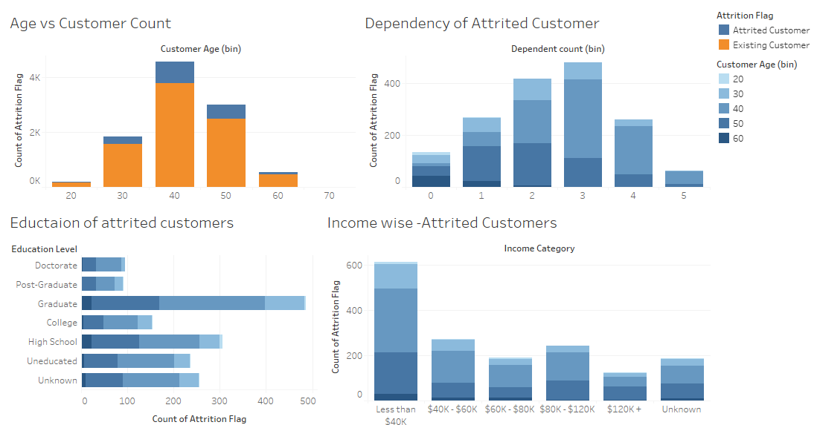
Demographic & Behavioral indicators

Slide 3
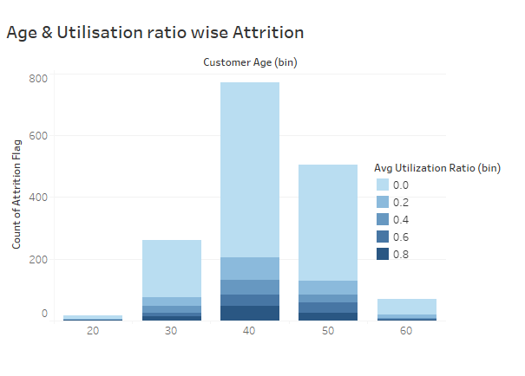
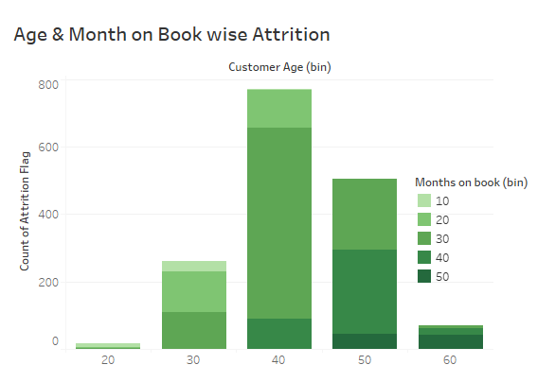
Demographic & Behavioral indicators
Insights on Age group
Attrition rate is equally high with acquisition rate for 30-50 Yrs Age Group.
Lower the Utilization higher the Attrition rate
Months on book with 20-30s need more attention.

Slide 4
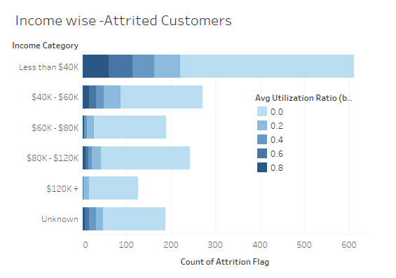
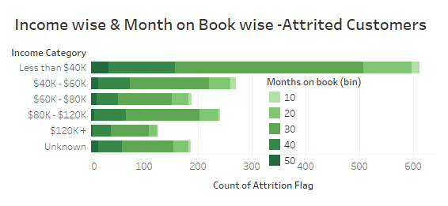
Demographic & Behavioral indicators
Insights Income wise
The lower the salary higher the attrition rate.
People with long association range 20-30Months tends to be attrited
Customers having lower utilization tends to be more attrited.

Slide 5
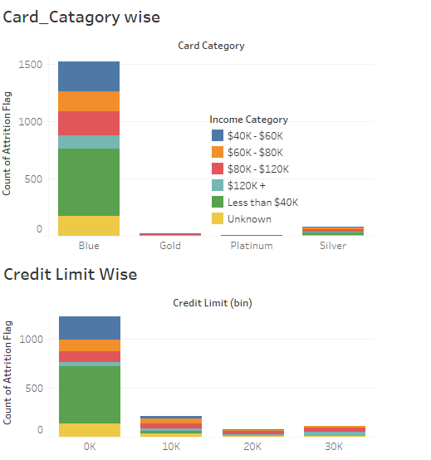
Credit Card type & Limit effects on Attrition
Insights Card limit & Type wise
Blue Category & Lower Card Limit seems to have higher attrition rate.
Lower Salary seems lower Credit Limit.
Major Focus should be on proper setting of Credit Limit of Income <80K $.

Slide 6
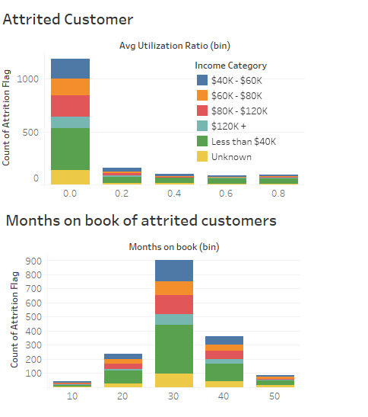
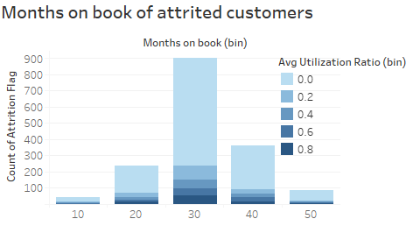
Utilization effects on Attrition
Insights - Utilization & Month on Books
Lower utilization seems higher attrition.
Lower Salary seems to use spend less on Credit Card hence the utilization is low.
Customer with 30-40 Months on Book with low utilization having higher attrition

Slide 7
Unfold the underlying Problem
Age
Retain 30-50Yrs age
Income
Focus on Salary <80K $
Credit Limit
Higher Credit limit for income <80K $
Utilization
Monitoring for lower utilization Customer
Months on Books.
30-40 Month customer
Customers with 30-50Yrs old Having less than <80K $ Salary tend to use spend less.
Spending less means low utilization .
The Spending Less may be due to many factors like- Low limit or less attractive offer.
After 30-40 Months of use such customer leaves.
Retention
Possible Strategy –
Work on the nature of spending of the attrited customers, Age wise & Month on book wise.
Launch some exiting offers for the above customer group to increase the spending.
Improve the Credit Limit.

Slide 8
Thank You
Do check the tableau – Link for more interactive insights
https://public.tableau.com/app/profile/deborit/viz/CreditCardcompany/Dashboard2?publish=yes

